Slide 1
Chapter 5 Iteration
By
Hyung Jae (Chris) Chang
Troy University

Slide 2

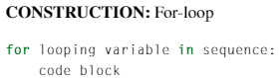
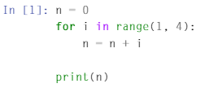
For Loops
A set of instructions that is repeated, or iterated, for every value in a sequence.
What is happening?
Create a sequence of numbers in range 1 through 3.
Iterate from 1 through 3

Slide 3
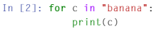
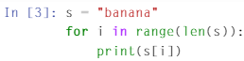
For Loops (cont.)
What’s happening?
String literal “banana” is a sequence of characters.
Iterate from “b” through “a” one by one and display them.
What’s happening?
Length of characters for string literal “banana” used to create a sequence of numbers.
By using an index i, access each character in “banana”.

Slide 4
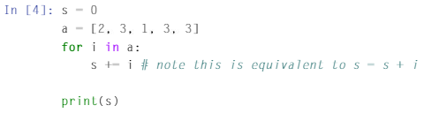
For Loops (cont.)
What’s happening?
List of numbers are stored in a variable “a” and use them as a sequence of the for loop.
In each iteration, we add each number in a to s.

Slide 5
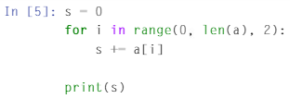
For Loops (cont.)
What’s happening?
Adding the numbers at even indices only.
range(0, len(a), 2) → from 0 to 5 with the step of 2 → access index 0, 2 and 4.

Slide 6
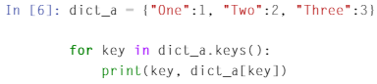
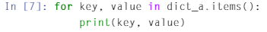
For Loops (cont.)
A for loop works in the same way for the dictionary.
What’s happening?
We use the method keys first to retrieve all keys.
We use the keys to access the values in dictionary.
How about this code? →
What’s happening?

Slide 7
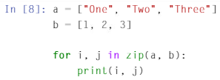
For Loops (cont.)
We can assign two different looping variables at the same time.
By using zip() function, we access two different sequences of the same length.

Slide 8
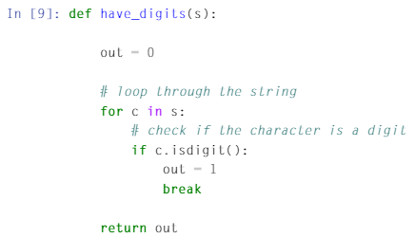
Break keyword
Checks if the passed string “s” has a digit or not.
“break” keyword will stop the loop and exit; this is used to stop the loop early.

Slide 9
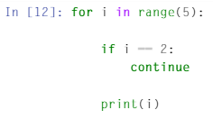
Continue keyword
“continue” keyword skips the remaining code in the current iteration of the for-loop and continues on to the next iteration.

Slide 10
Example
Let’s try this.
Let x be a two-dimensional array, [5 6; 7 8]. Use a nested for-loop to sum all the elements in x.
Firstly, create a variable x containg the two-dimensional array: x = np.array([5,6], [7,8]])

Slide 11
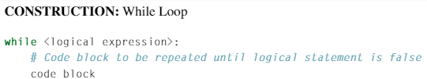
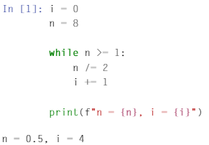
While Loop
A while-loop (or indefinite loop) is a set of instructions that is repeated as long as the associated logical expression is true.
Example

Slide 12
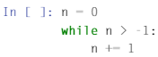
While Loop
If logical expression is always true, the result is known as an infinite loop → trouble!
If this takes place, the loop runs forever until the computer breaks or runs out of memory.
While loops can have nested loops like for loop.
For loop vs While loop
When the number of iterations is well-defined → better to use for loop
When the number of iterations is indefinite or not well-known → better to use while loop

Slide 13
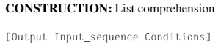
Comprehensions
In Python, there are other ways to do iterations; list, dictionary and set comprehensions are very popular ways.
Comprehensions allow sequences to be created from other sequences using very compact syntax.
Construction for List Comprehension:

Slide 14
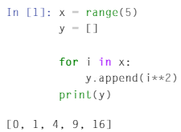
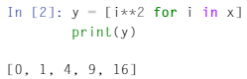
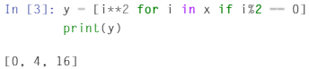
List Comprehensions
Example 1: If x=range(5), square each number in x and store it in a list y.
Example 2:
List Comprehension

Slide 15
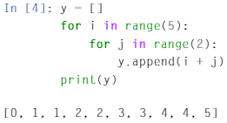
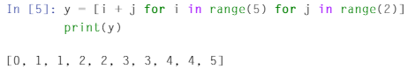
List Comprehensions (cont.)
Two levels for loops that we can perform the same task using list comprehension.

Slide 16
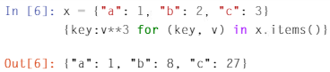
Dictionary Comprehensions
Example of dictionary comprehension

